Slide 1
Get Screwed by Fast Food
Kathan Gandhi

Slide 2
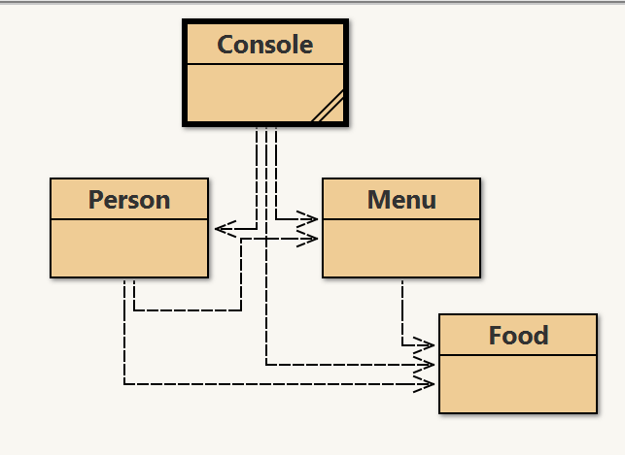
Overall Architecture

Slide 3
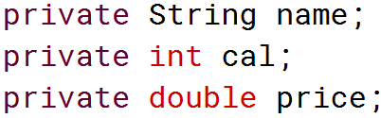
Food
Represents food item with name, calories, and price

Slide 4
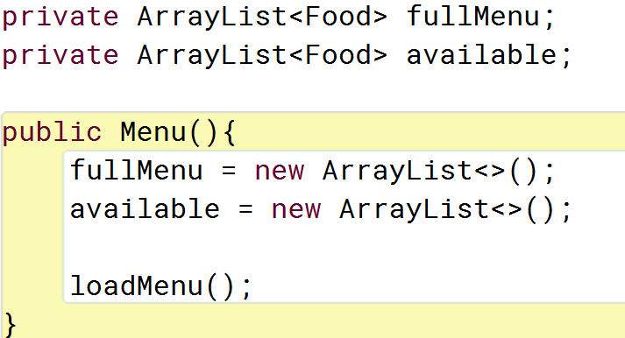
Menu
Represents the overall collection of Food items and also creates new menus for each occasion
Variables

Slide 5
Menu
Represents the overall collection of Food items and also creates new menus for each occasion
Methods

Slide 6
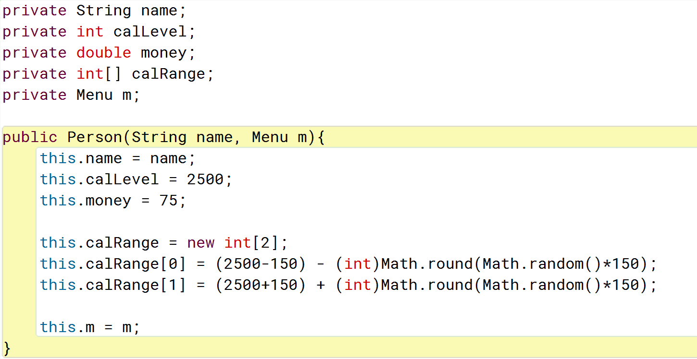
Person
Represents the player, his statistics, the decisions he can take and game effects upon him
Constructor

Slide 7
Person
Represents the player, his statistics, the decisions he can take and game effects upon him
Methods

Slide 8
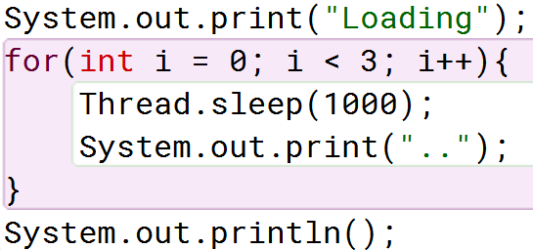
Console
Brings all components together and relays them onto the screen
Loading

Slide 9
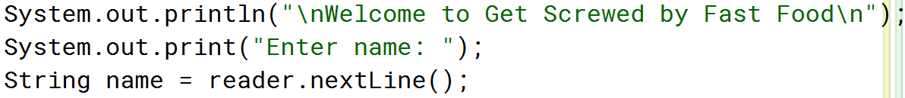
Console
Brings all components together and relays them onto the screen
Welcome

Slide 10
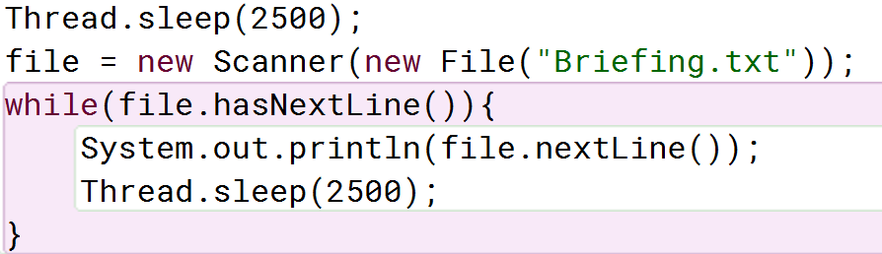
Console
Brings all components together and relays them onto the screen
Briefing

Slide 11
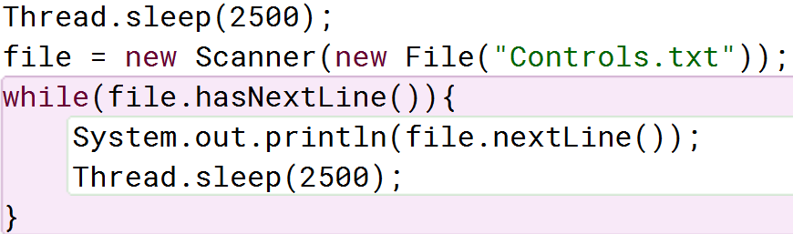
Console
Brings all components together and relays them onto the screen
Controls

Slide 12
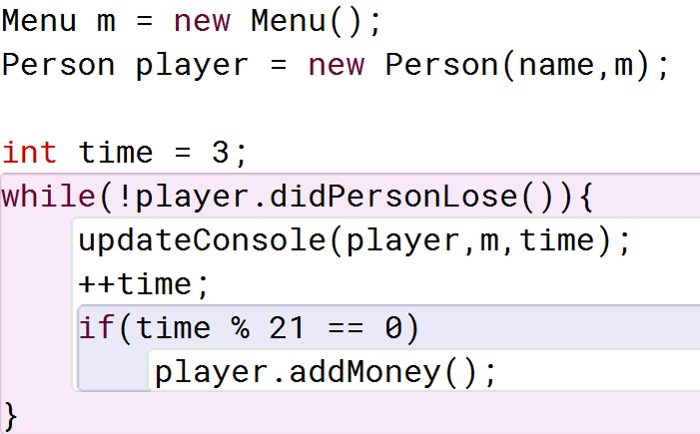
Console
Brings all components together and relays them onto the screen
Game Loop

Slide 13
Console
Brings all components together and relays them onto the screen
Update

